Slide 1
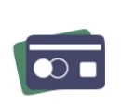


Credit Card Fraud Detection and Prediction
Team no. 10

Slide 2
Literature Survey
 | 1 Paper | 2 Article | 3 Article | 4 Article
Title | Credit card fraud detection using machine learning & data science | ML|Credit card fraud detection | Data science project – Credit card fraud with Machine learning in R | Machine Learning For Credit Card Fraud Detection System
Author | S P Maniraj | Aman sharma |  | Lakshmi SVSS, Selvani Deepthi Kavila
Publication | IJERT | GFG | DataFlair | Research India Pubications
Algorithms used | Isolation Forest Algorithm | Random Forest Algorithm | Decision Tree Algorithm | Decision Tree Algorithm
Dataset used | Kaggle | link | Ranger Caret Data.table | kaggle
Links | link | link | link

Slide 3
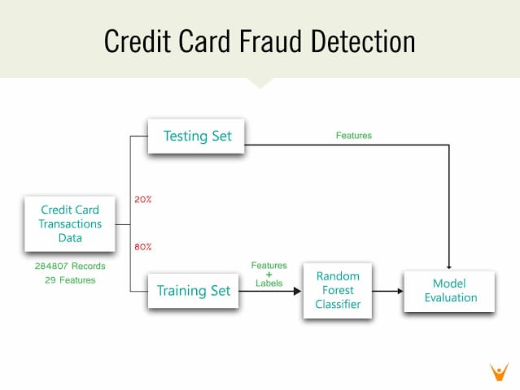
Block Diagram
Testing Set
Features
Credit Card Transactions Data
284807 Records
31 Features
Features
& Labels
Random Forest Classifier
Training Set
Model Evaluation

Slide 4
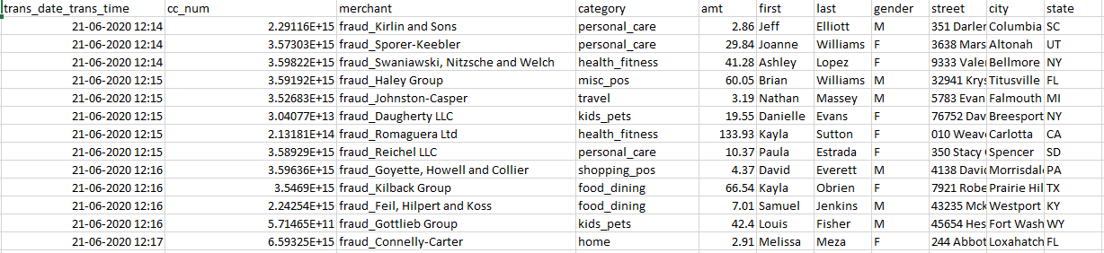
Dataset
https://www.kaggle.com/mlg-ulb/creditcardfraud?select=creditcard.csv

Slide 5
Features from Dataset
Transaction Time
Transaction Date
First Name
Category
City
State
Amount
Country
CC number
Gender
Zip Code
Date of Birth
Last name
Merchant
Street
Job

Slide 6
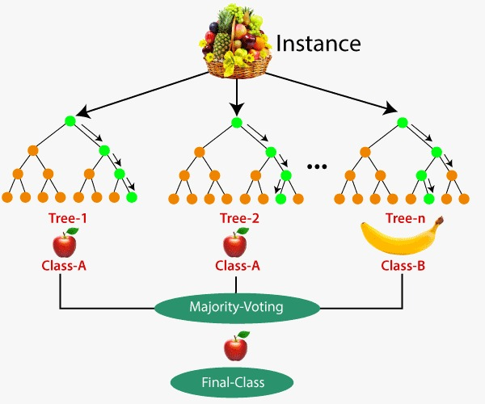
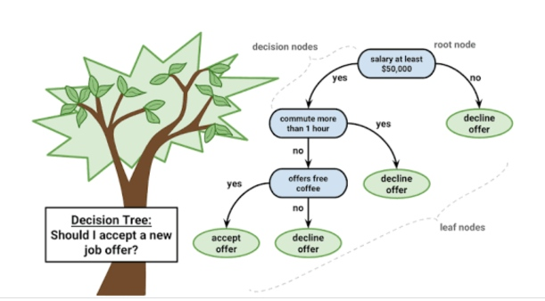
Decision tree
Random Forest Classifier

Slide 7
Random Forest Algorithm
How does Random forest work ?
The following are the basic steps involved in performing the random forest algorithm:
Pick N random records from the dataset.
Build a decision tree based on these N records.
Choose the number of trees you want in your algorithm and repeat steps 1 and 2.
In case of a regression problem, for a new record, each tree in the forest predicts a value for Y (output). The final value can be calculated by taking the average of all the values predicted by all the trees in forest. Or, in case of a classification problem, each tree in the forest predicts the category to which the new record belongs. Finally, the new record is assigned to the category that wins the majority vote.

Slide 8
Preprocessing steps on data set code
Acquiring of dataset
Import all the libraries & Dataset
Plotting Correlation matrix
Splitting of dataset
Training the Model
Plotting Confusion matrix

Slide 9
Confusion Matrix
A confusion matrix is a table that is often used to describe the performance of a classification model.
Help to gain inside into a type of error a model is making.

Slide 10
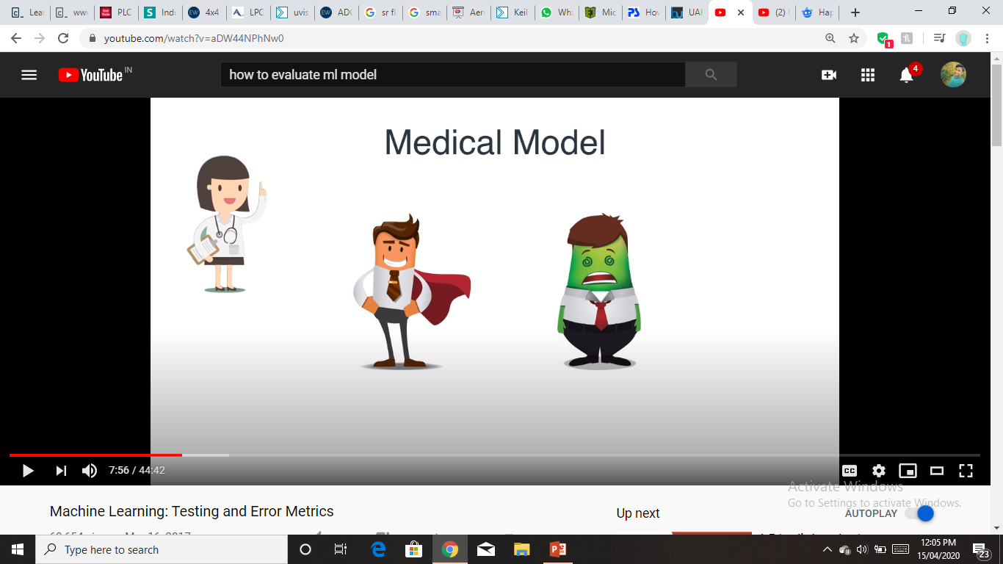

Medical Model
Healthy
Sick

Slide 11



 | Diagnosed Sick | Diagnosed Healthy
Sick
Healthy

Slide 12
Confusion Metrix
Diagnosis
 | Diagnosed Sick | Diagnosed Healthy
Sick | 1000 True Positive | 800 False Negative
Healthy | 200 False Positive | 8000 True Negative
Patients
10000
Patients

Slide 13
Accuracy
Diagnosis
 | Diagnosed Sick | Diagnosed Healthy
Sick | 1000 True Positive | 800 False Negative
Healthy | 200 False Positive | 8000 True Negative
Accuracy : Out of all the patient, how many did we classify correctly.
Patients

Slide 14
Accuracy
Diagnosis
 | Diagnosed SIck | Diagnosed Healthy
Sick | 1000 True Positive | 800 False Negative
Healthy | 200 False Positive | 8000 True Negative
Accuracy : Out of all the patient, how many did we classify correctly.
Patients
1000+8000
Accuracy =

Slide 15
Accuracy
Diagnosis
 | Diagnosed SIck | Diagnosed Healthy
Sick | 1000 True Positive | 800 False Negative
Healthy | 200 False Positive | 8000 True Negative
Accuracy : Out of all the patient, how many did we classify correctly.
Patients
1000+8000
Accuracy =
= 90%
10000

Slide 16
Precision and Recall
Precision
Recall
Percentage of positive instances out of the total predicted positive instances.
Percentage of positive instances out of the total actual positive instances.
TP
TP
Precision =
Recall =
TP+FP
TP+FP

Slide 17
Precision
Recall
Diagnosis
Diagnosis
 | Diagnosed Sick | Diagnosed Healthy
Sick | 1000 True Positive | 800 False Negative
Healthy | 200 False Positive | 8000 True Negative
 | Diagnosed Sick | Diagnosed Healthy
Sick | 1000 True Positive | 800 False Negative
Healthy | 200 False Positive | 8000 True Negative
Patients
Patients
1000
1000
Precision =
= 55.7%
Recall =
= 83.3%
1000+800
1000+200

Slide 18
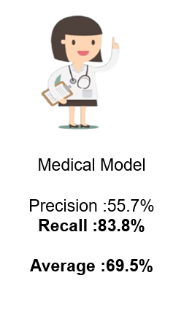
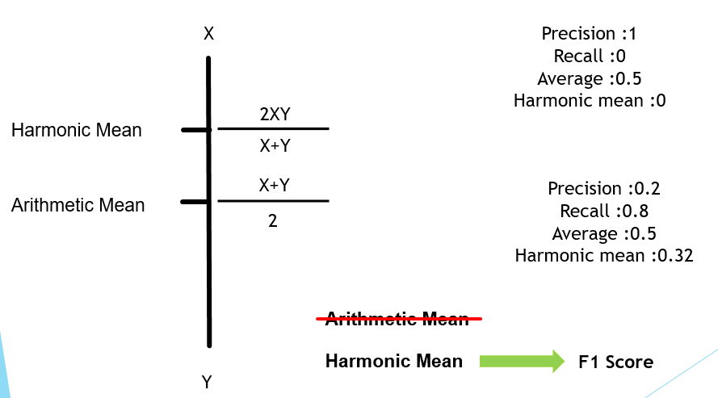
Harmonic Mean
-------------------------------------------------------

Slide 19
Code for reading and displaying
the dataset
import seaborn as sns
import pandas as pd
import matplotlib.pyplot as plt
data = pd.read_csv("credit.csv")
data.head()
print(data.shape)
print(data.describe())

Slide 20
Thank you
Sneha Nale
Akansha Thakarke
Sakshi Ugale

